Slide 1


SIR for Wide Band Gap Component Optimization for Hybrid Energy Storage System to Support Laser Based Capabilities for Future Vertical Lift
General Technical Services (GTS), LLC
1451 Route 34 South – Suite 301
Wall Township, NJ 07727
EaglePicher Technologies, LLC (Y2109-19-01)
2000 South County Trl
East Greenwich, RI
09/19/2019
WARNING - This document contains technical data whose export is restricted by the Arms Export Control Act (Title 22, U.S.C., Sec 2751, et seq.) or the Export Administration Act of 1979 (Title 50, U.S.C., App. 2401 et seq), as amended. Violations of these export laws are subject to severe criminal penalties. Disseminate in accordance with provisions of DoD Directive 5230.25.
Distribution Statement: This document contains proprietary data belonging to PC Krause & Associates, Inc (PCKA) and EaglePicher Technologies (EP). This document may not be distributed or disclosed without prior consent of PCKA and EaglePicher. Access to this printed document or electronic file does not constitute delivery of the data to the US Government as contemplated under the Federal Acquisition Regulation (FAR) or DOD FAR Supplement (DFARS). All requests to disseminate this information should be referred to PCKA and EaglePicher for written approval.

Slide 2
Contract Background
Contract: | GTS Prime Contract W56KGU-18-C-0025
Task Title: | Soldier Tactical/Expeditionary Power & Energy Generation Services
Government POC: | Anthony DeAnni
Contract Period of Performance: | 27 June 2018 - 20 June 2023

Slide 3
Requirements Summary

Slide 4
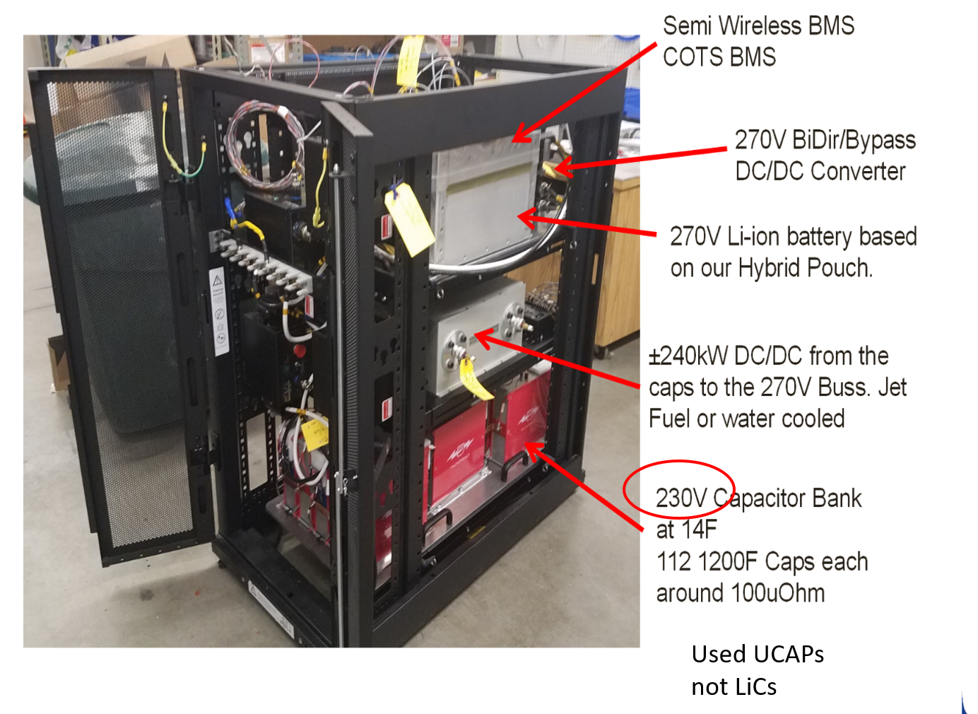
Background

Slide 5
Summary of the Requirements
The system shall provide a minimum of:
60kW at nominal 270V for a minimum of 2 seconds. (Phase I)
300kW at nominal 270V for 60 seconds. (Phase II)
The system shall have an ESD input voltage range of 275 Vdc to 400 Vdc.
The system shall have a load voltage of 270 Vdc. (Mil-Std 704)
The system shall have control voltage of 28 Vdc. (Mil-Std 704)
The system shall utilize the following for power module:
Lithium ion capacitors (LiCs). (Phase I)
Lithium ion battery cells (LiBs). (Phase II)
The system shall utilize wide band gap DC/DC converters to supply regulated 270VDC power to the target application.
The system shall utilize wide band gap components, such as Silicon Carbide (SiC) or Gallium Nitride (GaN), to provide power output for:
greater than 2 seconds. (Phase I)
up to 60 seconds. (Phase II)
The system shall be capable of being configured in a parallel configuration in order to increase power output.
The system shall be liquid cooled with water or glycol at 20°C or less with ISO 7241-1 Series B Quick Disconnect.
The system shall have an HMI (computer, tablet, panel, etc) for control.
The system shall use Rebling 7000 series power connectors and GND connections.
The system shall be rack mounted.
The system shall utilize MIL-DTL-38999 Series III, Class M signal connections.
The system shall utilize CAN bus for communication with the BMS.
In place of terminal blocks for high power. Safer and cleaner

Slide 6
Deliverables by Phase
Phase 1 (funded)
The 300kW converter connected to a capacitor bank that allows it to operate at up to 60kW for at least 2 seconds.
Total stored energy requirement: 120kJ
Actual delivered energy will be around 500kJ to 1000kJ, depending on the rate (150kW vs 60kW)
Phase 2 (unfunded)
The 300kW converter connected to a battery bank that allows it to operate at up to 300kW for at least 60 seconds.
Total stored energy requirement: 18MJ

Slide 7
Capacitor Evaluation (Summary from PDR)

Slide 8
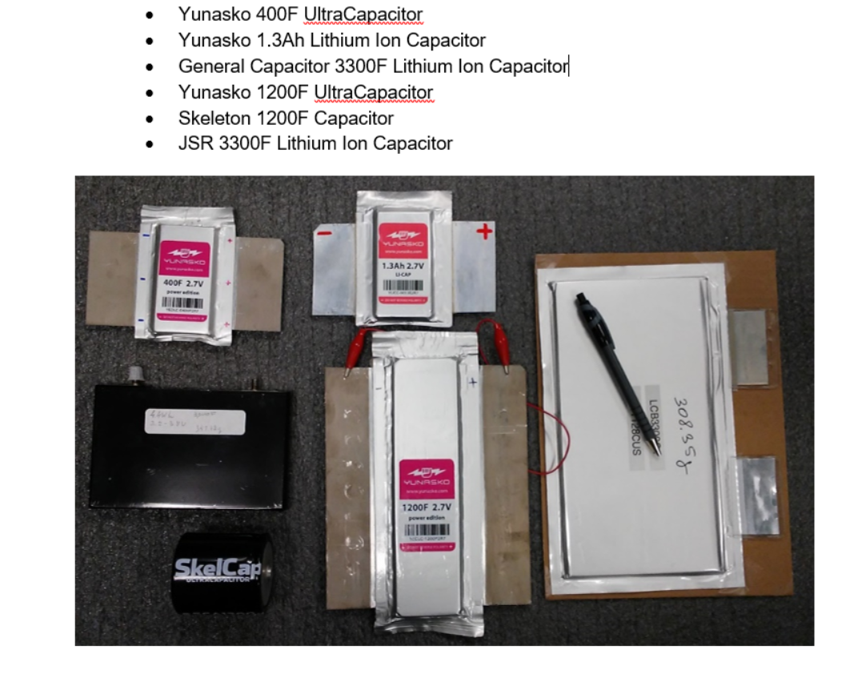
Options Reviewed
The goal of Phase 1, the funded Phase, is to be able to deliver at least 60kW for 2 seconds.
This is sufficient time to test each converter at 60% of power.
We are not at 2 converters so 60kW is 40%, but the better caps over perform so we tested at 100kW (67%) and beyond
PCKA / EP Proprietary / ITAR Technical Data (See Cover Page for Distribution Statement)

Slide 9
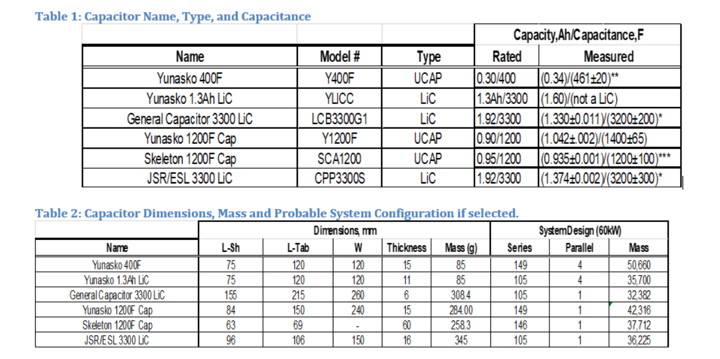
Theoretical Designs to Meet Minimum Requirements….
PCKA / EP Proprietary / ITAR Technical Data (See Cover Page for Distribution Statement)

Slide 10
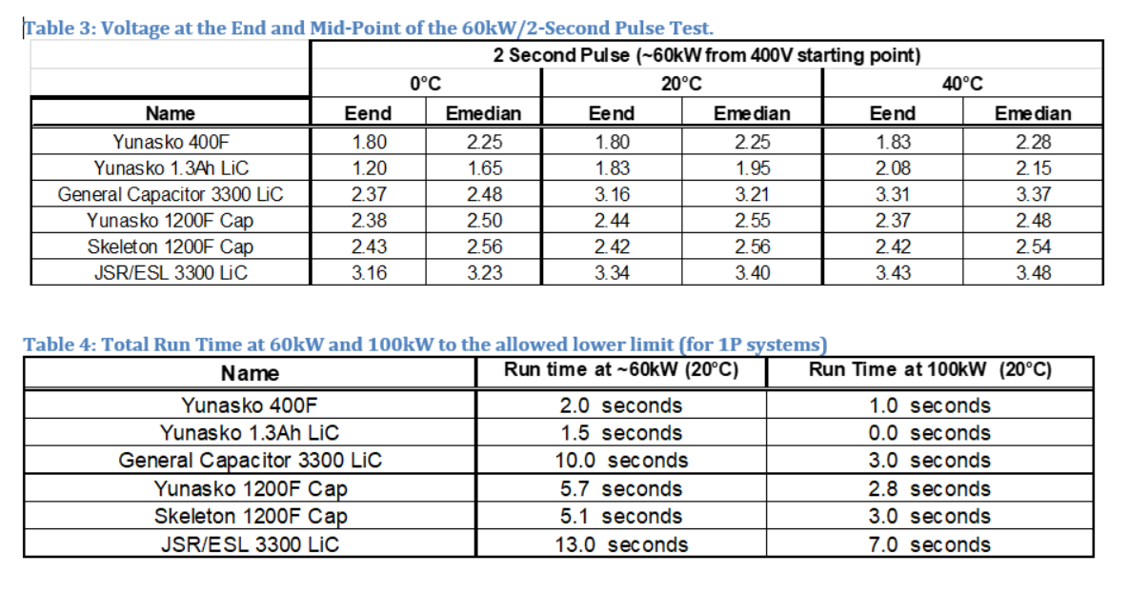
Testing Results---Summary
PCKA / EP Proprietary / ITAR Technical Data (See Cover Page for Distribution Statement)

Slide 11
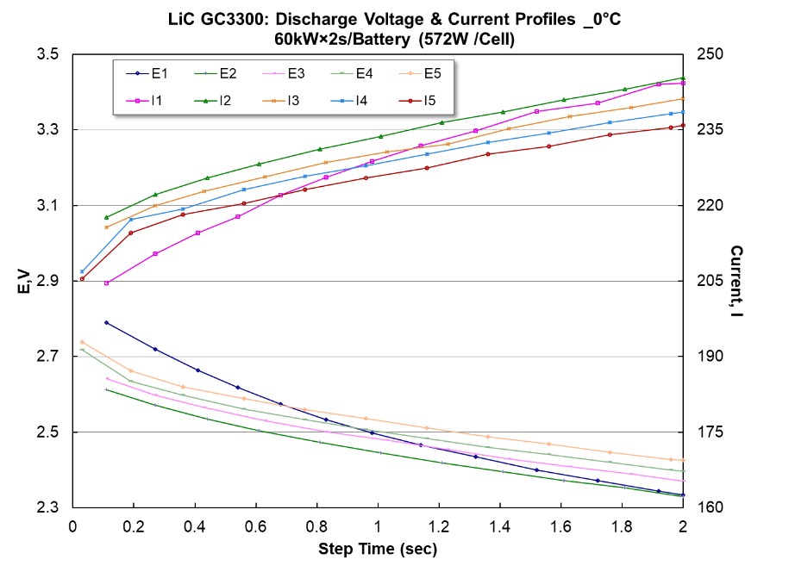
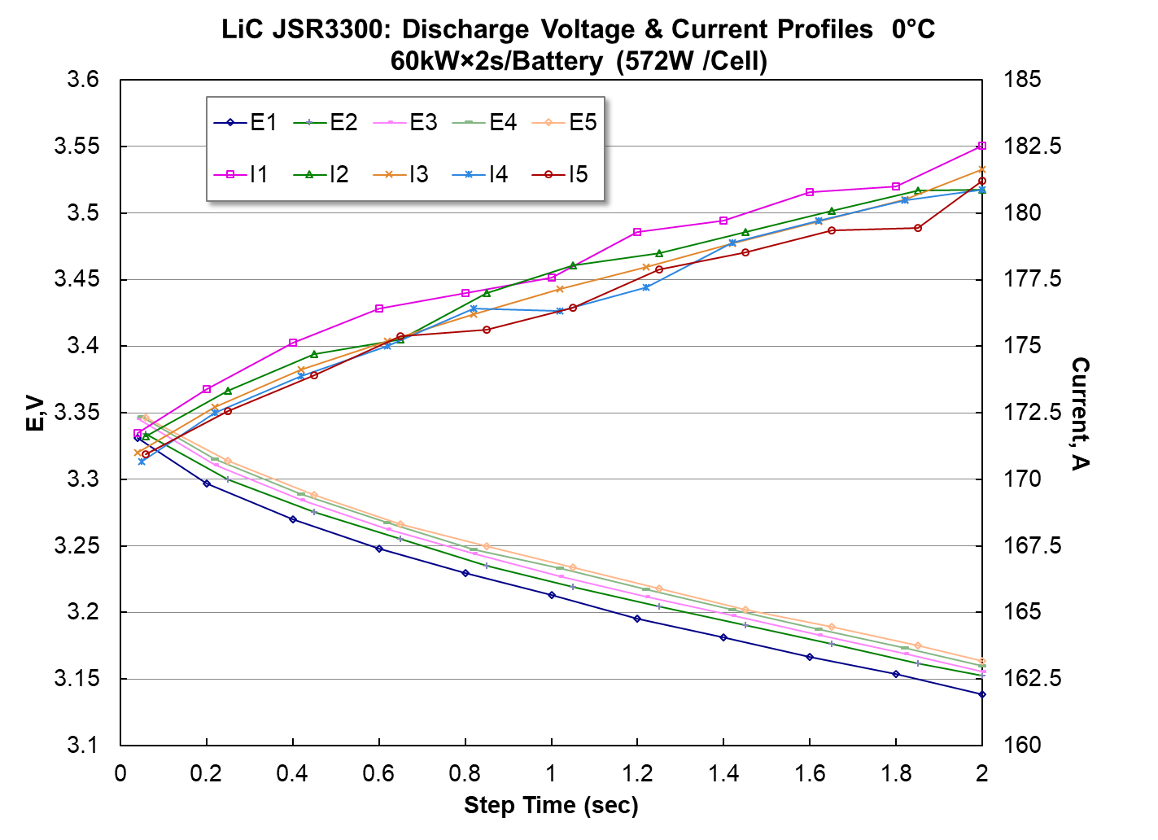
Comparing the Best Options (60kW at 0°C)

Slide 12
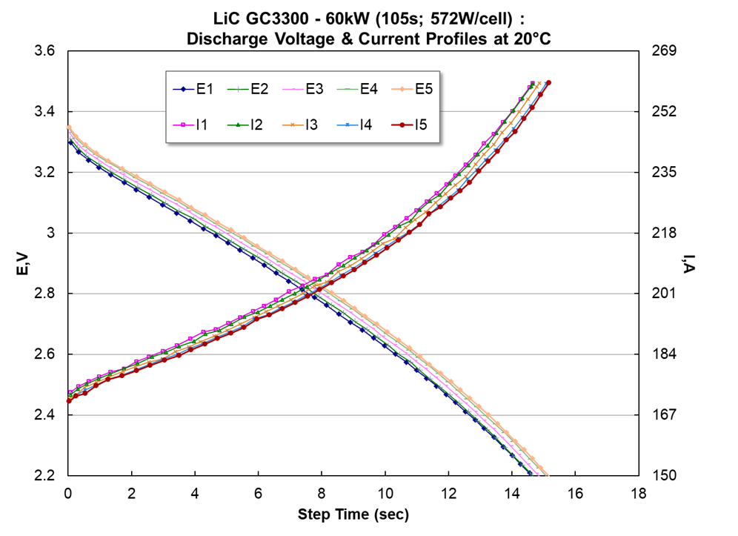
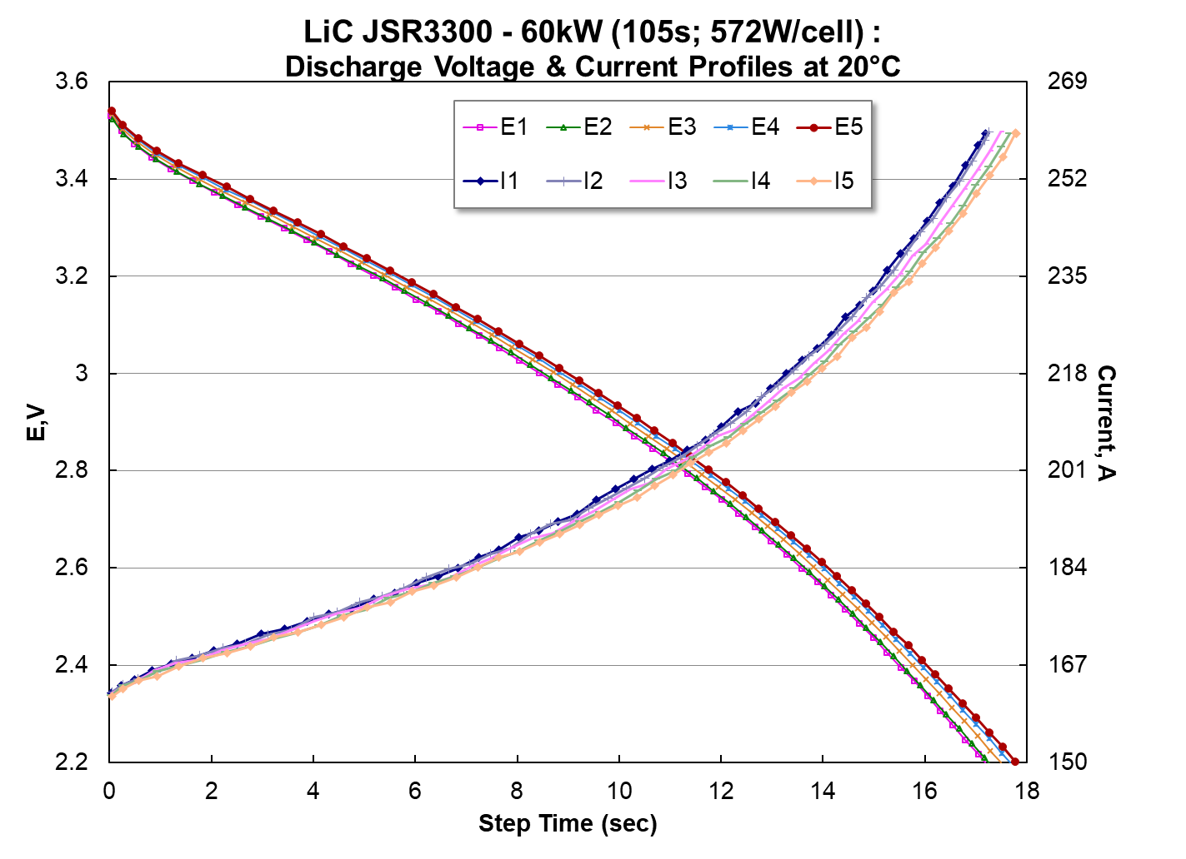
Comparing the Best Options (60kW at 20°C)

Slide 13
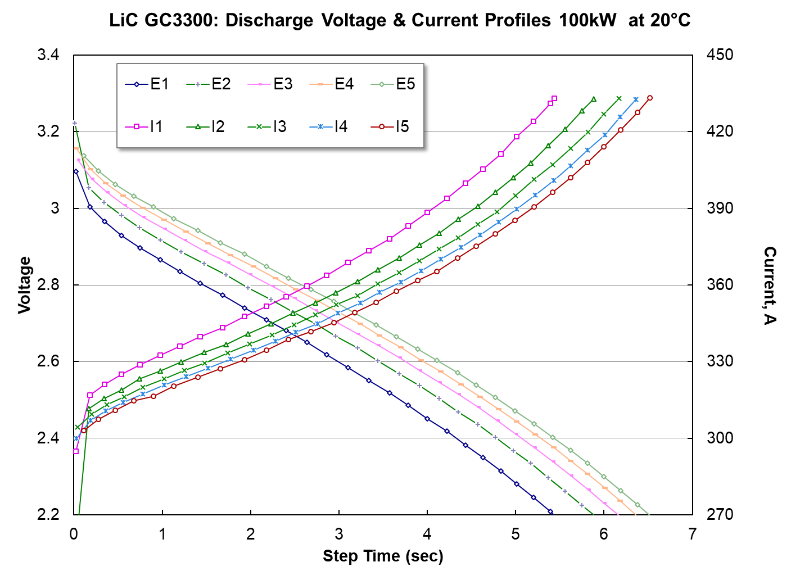
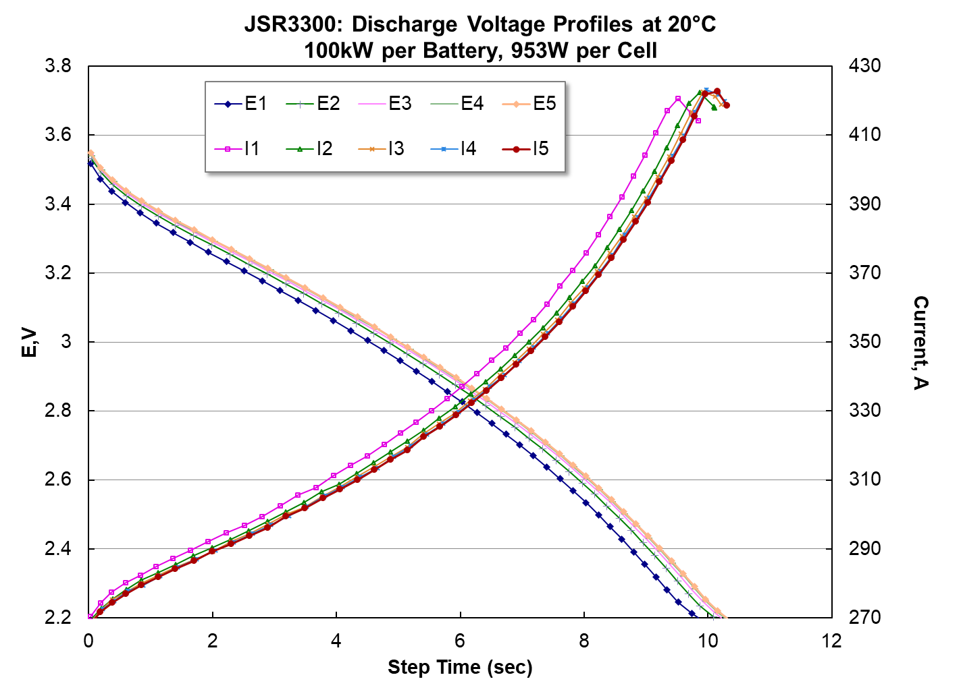
Comparing the Best Options (100kW at 20°C)
Far better performance and less variation.

Slide 14
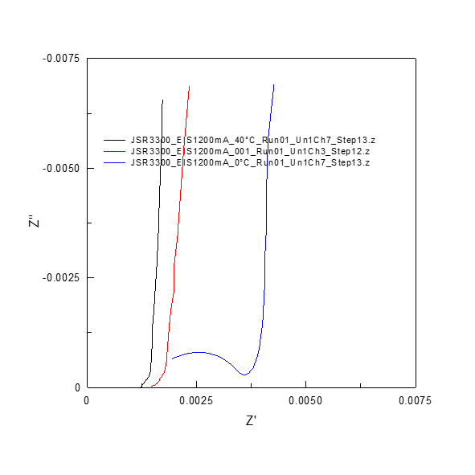
EIS Plots
Nyquist Plots
Bode plots
Summary: there is a dramatic drop off in performance between 20°C and 0°C

Slide 15
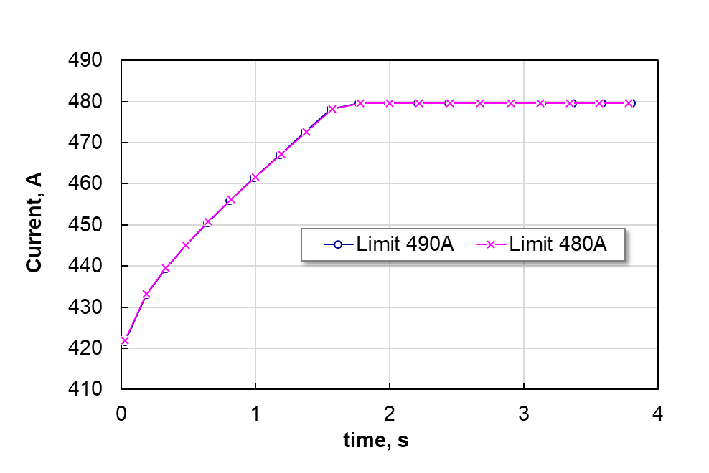
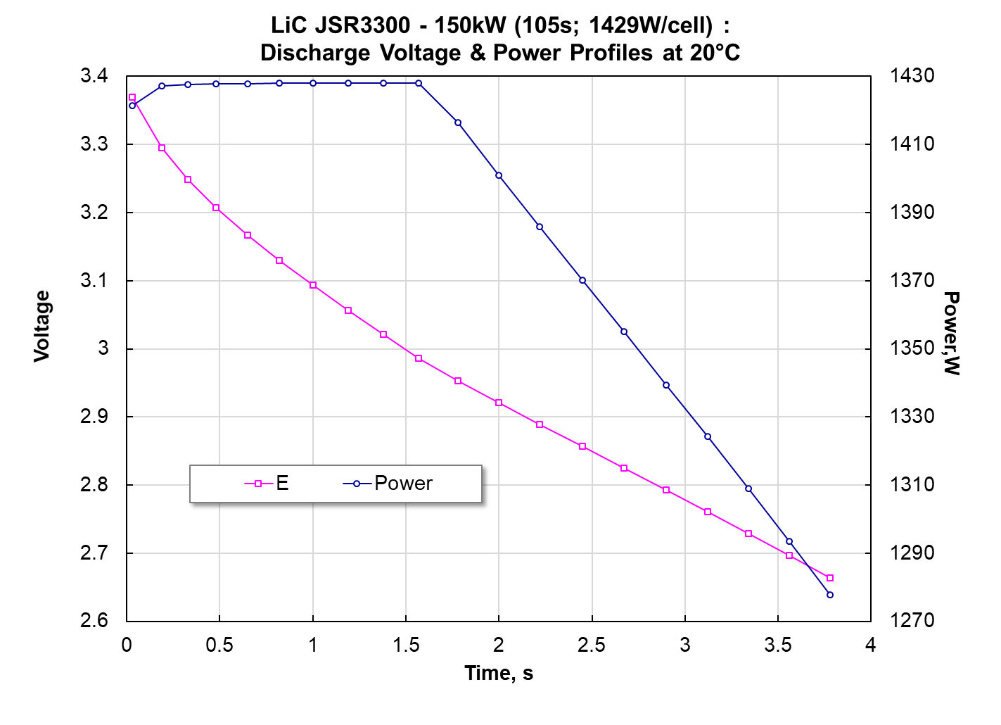
What about 150kW out of a JSR?
The test was limited by the 500Amp current limit on the cycler. But, we demonstrated 1.5 seconds at 150kW (scaled to pack) and extrapolate to 3.5 seconds of run time above 275V
PCKA / EP Proprietary / ITAR Technical Data (See Cover Page for Distribution Statement)

Slide 16
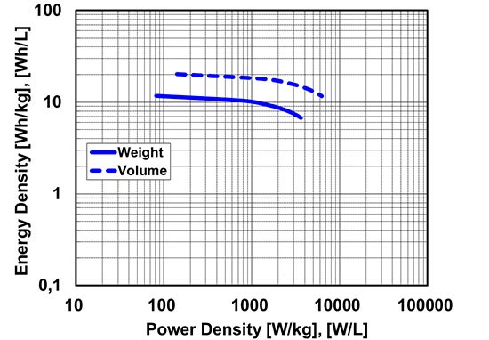
At 150kW….(4kW/kg)
PCKA / EP Proprietary / ITAR Technical Data (See Cover Page for Distribution Statement)

Slide 17
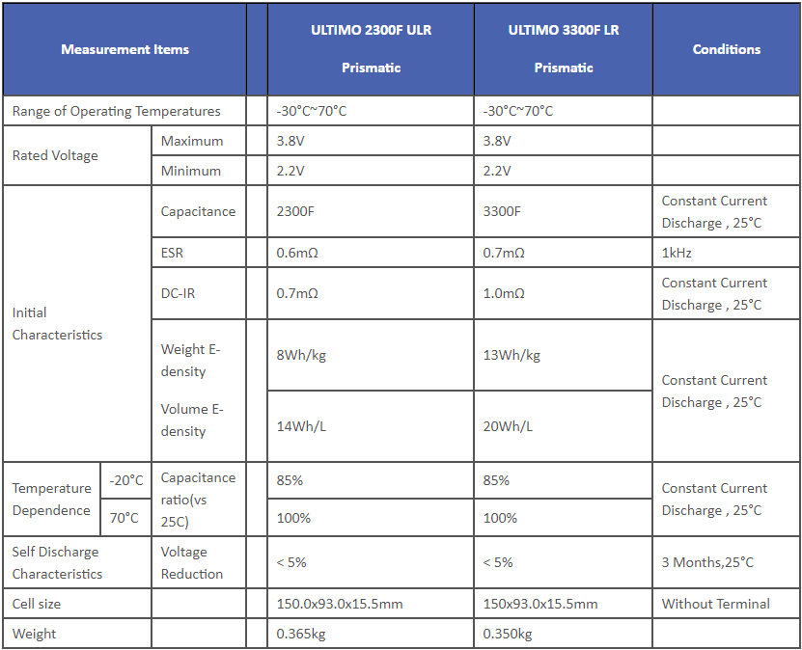
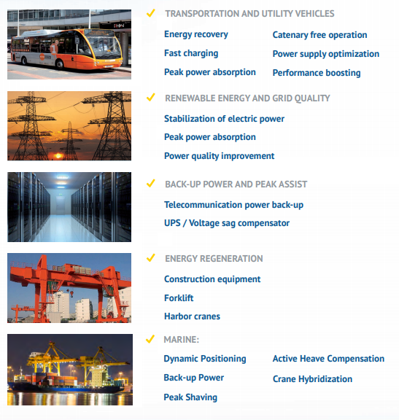
About the JSR Capacitor
PCKA / EP Proprietary / ITAR Technical Data (See Cover Page for Distribution Statement)

Slide 18
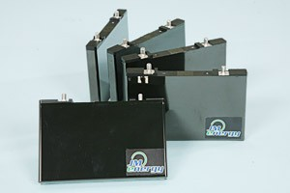
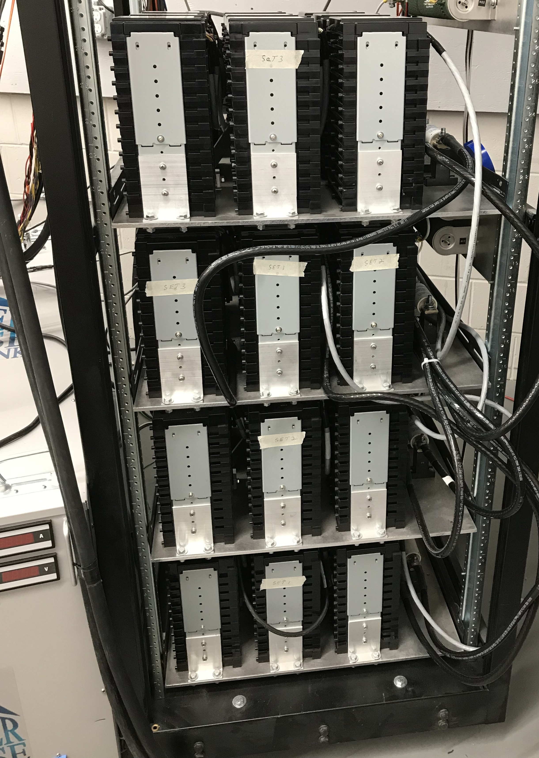
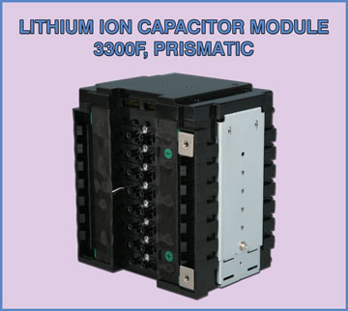
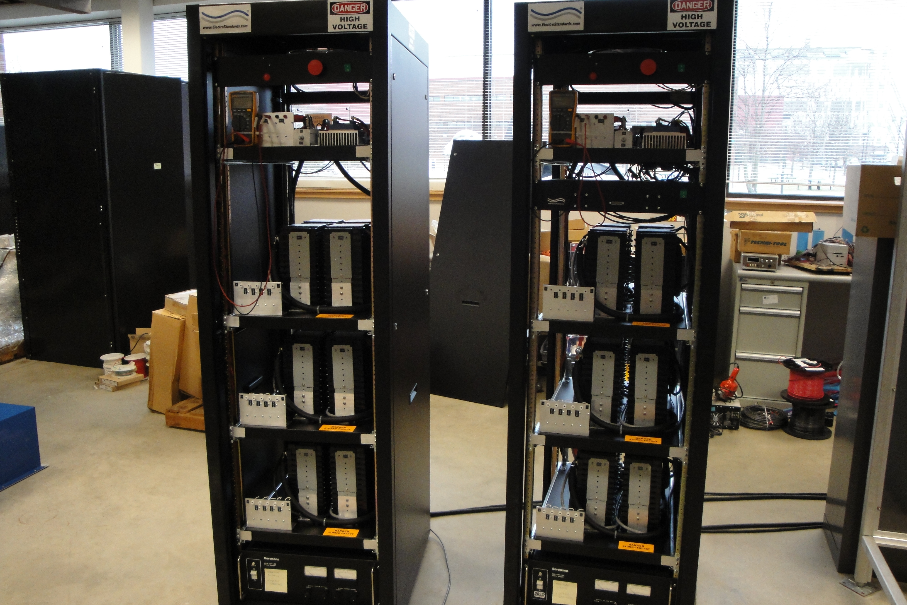
About the JSR Capacitor
This is an aluminum hard cased, Li-ion capacitor, that is case positive.
The hard case means that it isn’t altitude sensitive like a pouch could be.
It is in full production and has passed all of the transportation safety requirements
It is available in existing modules with a Capacitor Management System Built in
PCKA / EP Proprietary / ITAR Technical Data (See Cover Page for Distribution Statement)

Slide 19
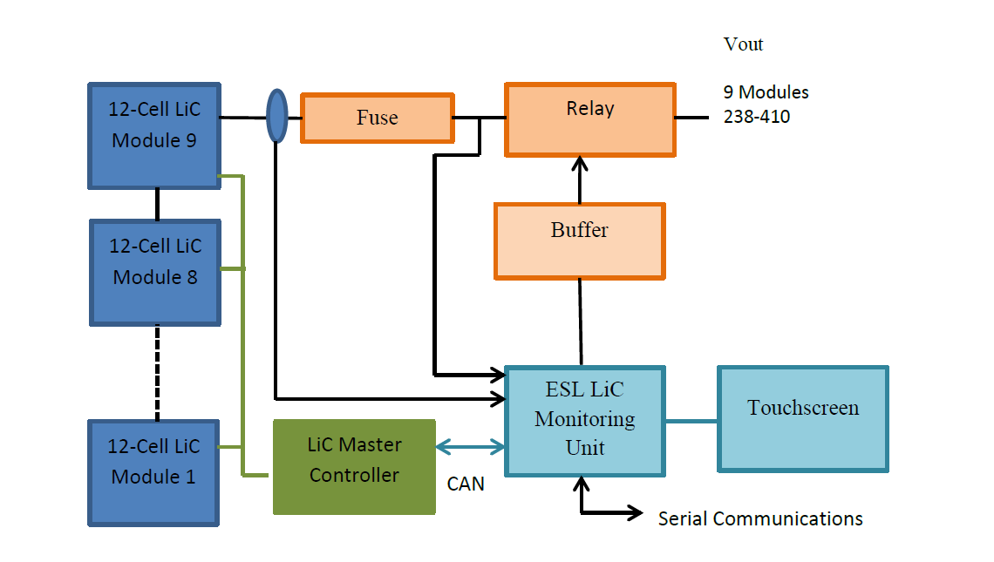
Capacitor Schematic
Volts

Slide 20
Moving Forward
The US Integrator for the JSR capacitors is Electro Standards Laboratories.
They are accustomed to working on military programs (e.g. EMALS with General Atomics)
The design consists of 9, twelve-cell modules in series
Max Average Capacitor Voltage: 3.703V versus 3.800V design max
Minimum Average Capacitor Voltage: 2.546V versus 2.200V design max
>unlike regular capacitors, LiC CANNOT BE ALLOWED TO BE DISCHARGED TO ZERO VOLTS
10 Capacitor Banks have been ordered and
PCKA.EP/ESL are currently reviewing the SOW for the integration of the power and communications with the PCKA converter…that is summarized in this meeting
PCKA / EP Proprietary / ITAR Technical Data (See Cover Page for Distribution Statement)

Slide 21
Phase 2 Li-ion Options

Slide 22
Phase 2 Goals
EP was tasked with performing testing relative to the goal of achieving 300kW for 60 seconds in a future phase.
We would want/need the voltage range of the capacitors to remain constant.
Operating from 400V to 275V
So we assume 96 or 98 cells in series and choose to operate at a slightly lower max OCV during “normal conditions” so as to maximize life.
PCKA / EP Proprietary / ITAR Technical Data (See Cover Page for Distribution Statement)

Slide 23
Phase 2 Goals
300kW divided by 96 cells is 3125 Watts.
The 60 second requirement is, by definition a 60C rate. (reality is a little different)
Thus, 3125Watts for 60 seconds is 52Wh.
This is 52.1Wh.
We can assume an average voltage of about 3.4V at the 60C rate.
Thus, we are looking at a 15.3Ah requirement
PCKA / EP Proprietary / ITAR Technical Data (See Cover Page for Distribution Statement)

Slide 24
The 18Ah cell at 20°C (we can expect 7-10% more energy at 35°C)
This data tells us that the 18Ah cell is a good solution though the ~3kW 288kW range.
This is at the battery level, not the output of the converter.
Operation at 1200Amps, which is about 18% overpower assuming a converter efficiency of 92% only gives a run time of 48 seconds.
Extrapolation between the two points is not linear but would give us around 50 seconds.
Operating Warmer (40°C) would get us very close to 60 seconds at BOL.
PCKA / EP Proprietary / ITAR Technical Data (See Cover Page for Distribution Statement)

Slide 25
Effect of Temperature at High Rates
PCKA / EP Proprietary / ITAR Technical Data (See Cover Page for Distribution Statement)

Slide 26
Summary…
After reviewing the performance of the 18Ah cell EaglePicher has found that the ability to meet 60 seconds at 325kW (sourced) is very close if
We assume that we can operate at 35°C -40°C
We assume that there is at least some level of pause within that discharge
We assume there is some low level of power available from the vehicle during the load.
Just that the recharge power is present during the load
We assume that EaglePicher can further optimize the system around this “medium rate” within the next year.
Thus, we have based the Phase 2 on our 18Ah module
Two modules in parallel would be overkill.
The other option is 4 our of 5.5Ah cells (same chemistry) in parallel but we don’t have modules for that at this time. The only advantage would be if there was a desire for a distributed energy source.
PCKA / EP Proprietary / ITAR Technical Data (See Cover Page for Distribution Statement)

Slide 27
Physical Packaging

Slide 28
Electrical Architecture
PCKA / EP Proprietary / ITAR Technical Data (See Cover Page for Distribution Statement)

Slide 29
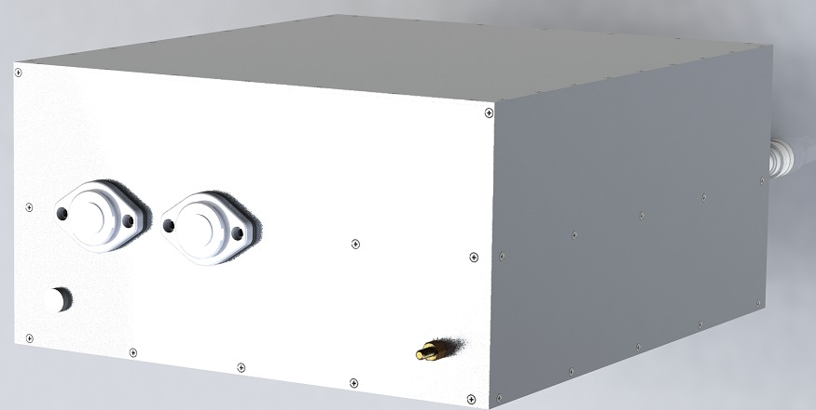
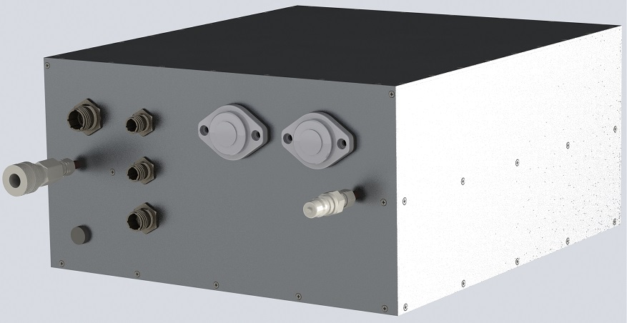
300 kW Converter Module
Component | Selection | Vendor | Description | Status
PSM | PCA_PCKA_146B | Adv. Assembly, PCKA | Power-stage module, GaN 4th generation | Preliminary testing complete
MCM | PCA_PCKA_138A | Adv. Assembly, PCKA | Microcontroller module (TI Delfino series) | Preliminary testing complete
PEM | TBD | Adv. Assembly, PCKA | Peripheral expansion module | Not started
EMI-filter | PCA_PCKA_163A | Adv. Assembly, PCKA | EMI-filter for 270 V bus and ESD | Design
Contactors | K1K06H024EAFA | TE Connectivity | Bi-directional breaking, 1000 Adc (1200 Adc for 180s) | 10-weeks lead time
Connectors, control | 38999 Series III | Wesco Air | Standard low-current connector series for military application | In-house
Connectors, power | XFT Series | Rebling, Bisco | Single-pole feed-through terminals, 2000 A 60s rating | In-house
Cold plate | Custom | Wieland Microcool | Liquid cold plate with micro-channels | Design
Housing | Custom | TBD | Aluminum panels, anodized (MIL-A-8625 Type III, Class 1) | Design
Converter module details:
Single converter solution instead of two parallel converters
Non-isolated parallel converters with the same source and load cannot guarantee current sharing in return path -> ineffective common-mode EMI-filter
New solution utilizes parallel converter structure internally but combines EMI-filters with a single common-mode choke, thus reducing current sharing problematic
Preliminary dimensions are 15” x 17” x 7.75” (dependent on cold plate design)
Preliminary weight estimate is 75 lbs for total converter
Module is sealed from environment:
Brazed or epoxied side panels
Lid has o-ring incorporated
No internal fluid connections, i.e. all coolant interfaces are outside of sealed module
Mounting tabs will be included with housing baseplate
PCKA / EP Proprietary / ITAR Technical Data (See Cover Page for Distribution Statement)

Slide 30
Precharge Module
Precharge module details:
Requirement for main converter operation is that source voltage is lower or equal to ESD voltage
There are potential operating conditions such as deep discharge of the ESD that may drop the ESD voltage below the source voltage that is available to charge the ESD (assumes a fixed 270 V dc bus)
Hence, a simple charge circuit is required that allows the ESD to be charged up:
First, connect main power resistor (4 Ω, 600 W) through S1 from source the ESD
Once delta voltage between source and ESD is less than 2 V, close S2 to connect 0.1 Ω, 20 W resistor for final charge push
When delta voltage between source and ESD is less than 0.5 V, open both S1 and S2
The sequencing will be controlled by the main converter
Both positive and negative connections are broken by S1 (DPST contactor) to avoid additional current return path when main converter is operating
PCKA / EP Proprietary / ITAR Technical Data (See Cover Page for Distribution Statement)

Slide 31
Capacitor Schematic

Slide 32
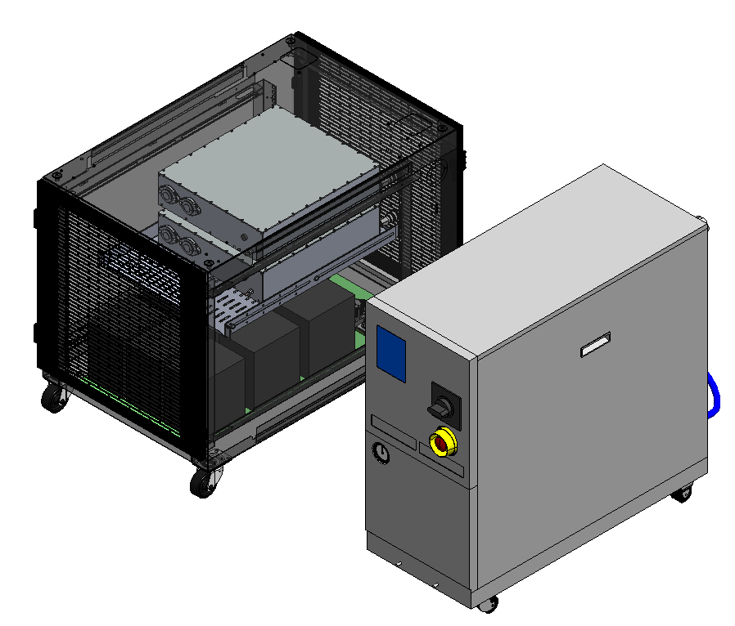
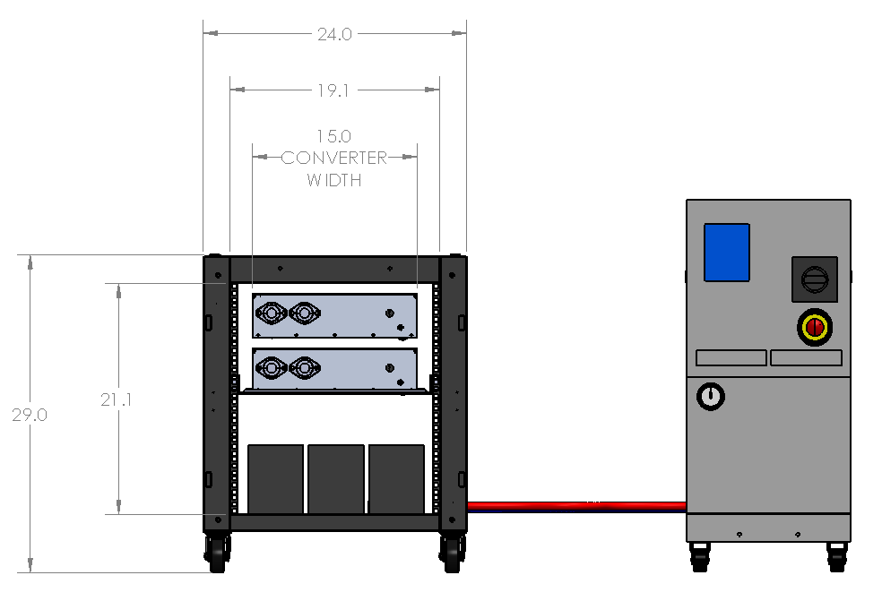
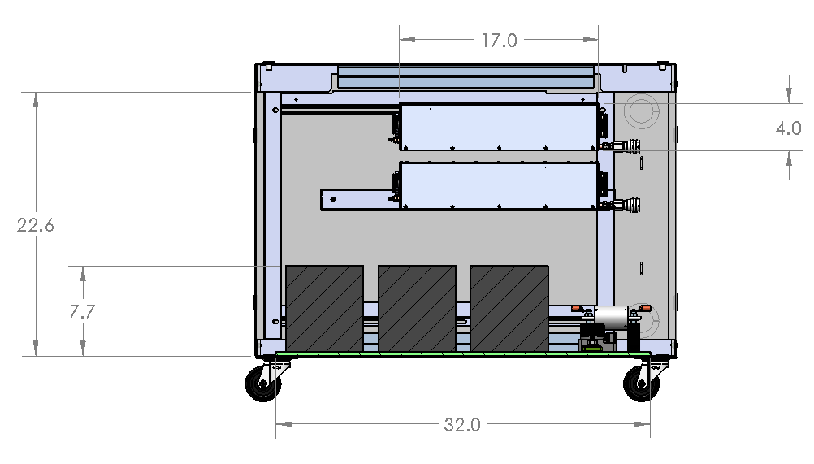
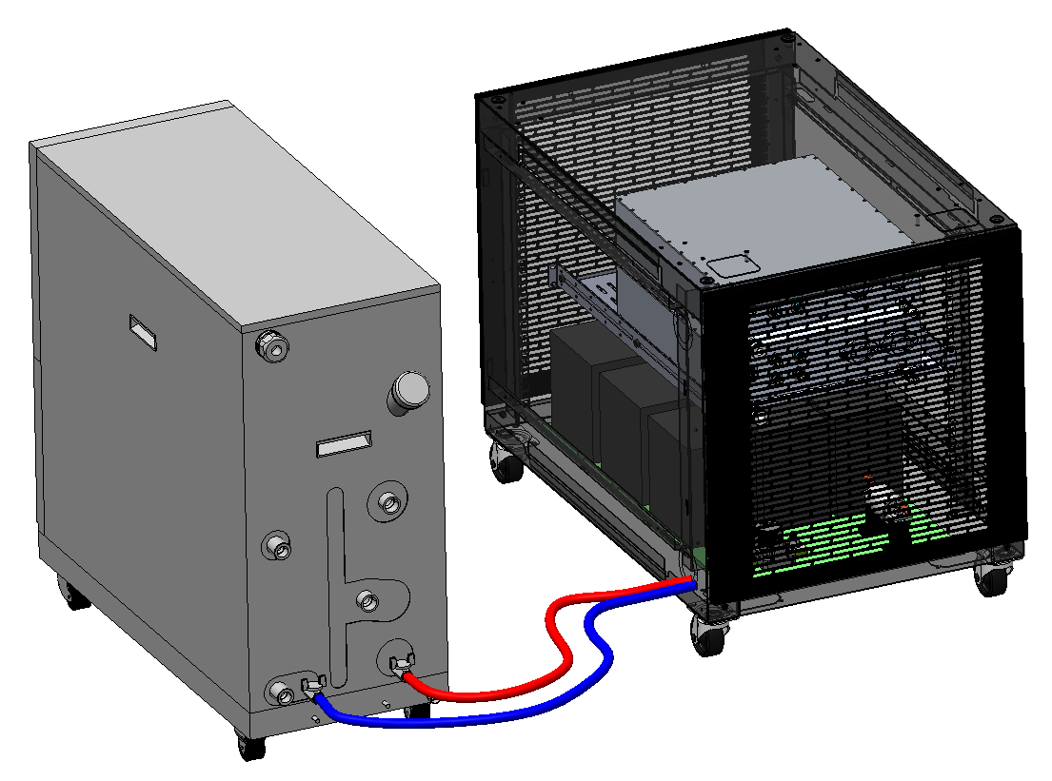
CERDEC 2.0 - Phase 1 Packing and Electrical Integration
Knockdown stacking rack cabinet
1500 lb weight capacity
High airflow perforated doors
Locking/swivel wheels
Lithium ion capacitor module bank
(9) 12 cell 3300F capacitors in series
300kW Bi-directional buck converter
Chilling unit
Min. Flow – 2.6 Gpm
60/40 Glycol/Water mix

Slide 33
Energy Storage System Interface

Slide 34
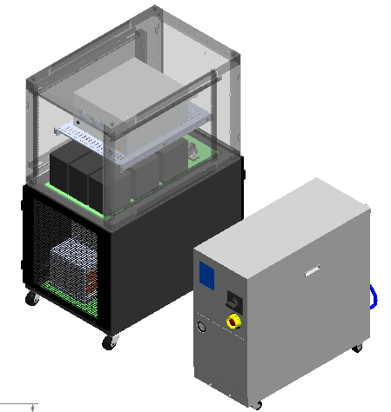
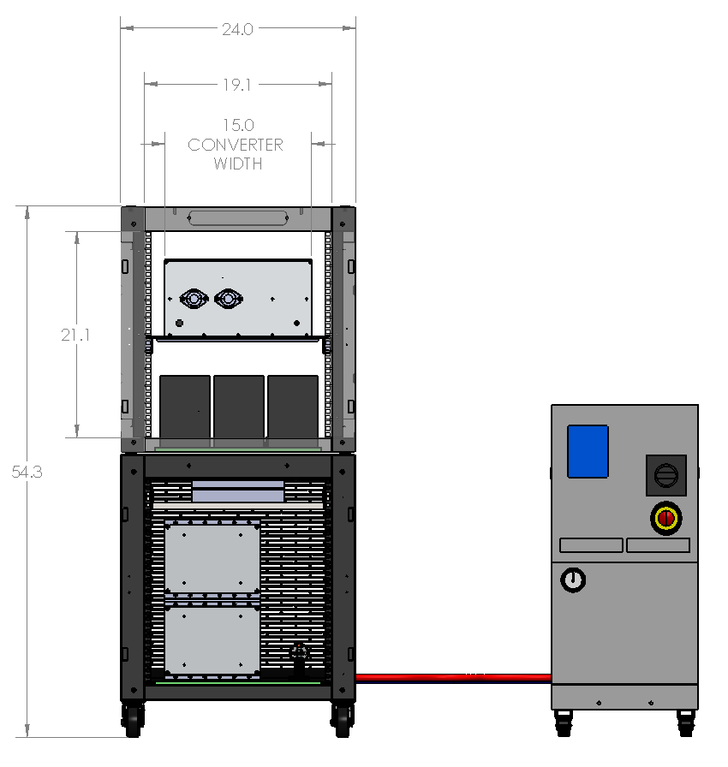
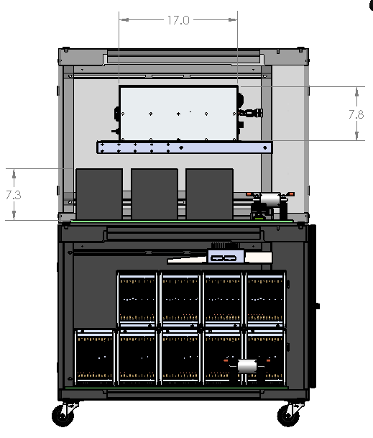
CERDEC 2.0 - Phase 2
300kW Bi-directional buck converters
Lithium ion capacitor module bank
(9) 12 cell 3300F capacitors in series
BMS
Fuse
Lithium ion battery module bank
(8) 12 cell (18Ah) modules in series

Slide 35
System Architecture / Overview
PCKA / EP Proprietary / ITAR Technical Data (See Cover Page for Distribution Statement)

Slide 36
Wiring Interface List (to be updated with final)

Slide 37
Interface 1, LC1: Cooling - pcka/esl
Liquid cooling provided for Converter Module
Glycol/Water mixture pumped through at 2.5 GPM, 20ºC (To Be Confirmed)
EP providing connectors, tubing, and external pump. ESL responsible for internal routing
ISO 7241-1 Series B Quick connectors, 316 stainless steel, TBD size

Slide 38
Interface 2, P1: 270V source - pcka
Source terminal to load terminal connection, positive and negative
4/0 AWG wiring to support full current capability based on existing understanding of load cycle
External connection through power connector (prefer Rebling 7000 Series)
Source current is monitored with integrated current sensor (see C1) to allow control flexibility (voltage, current assist, etc.)

Slide 39
Interface 3, P2: Load Connection - pcka
Load terminal to converter connection, positive and negative
4/0 AWG wiring to support full current capability based on existing understanding of load cycle
External connection through power connector (prefer Rebling 7000 Series)
Converter connection with Rebling XFT series (feedthrough terminal block)

Slide 40
Interface 4, P3: power from capacitors - esl
Main power connections from ESL Capacitor bank to dc-dc converter
Converter connection with Rebling XFT series feedthrough terminal block
ESD connected directly with 4/0 lugs
Output is Fuse protected (value TBD)
Voltage and current measurements of output to prevent overcharge/over discharge
Output can be monitored on touchscreen

Slide 41
Interface 5, P4: capacitor precharge MODULE in - pcka
Precharge module source connection, positive and negative
Allows ESD charging from a voltage level below to a value above the source voltage (main converter can only operate with ESD voltage higher than source voltage)
14 AWG wiring to support 20 A of charge current
XFT terminal block (converter) and D38999 Series III connector (precharge)

Slide 42
Interface 6, P5: capacitor precharge MODULE out - pcka
Precharge module ESD connection, positive and negative
Purpose see previous slide
14 AWG wiring to support 20 A of charge current
XFT terminal block (converter) and D38999 Series III connector (precharge)

Slide 43
Interface 7, CP1: control power in to control block - esl
28 Vdc used for control power in converter and ESL cap bank monitoring system
Power is brought to distribution block and split into the respective equipment
External connection made through D38999 Series III connector

Slide 44
Interface 8, CP2: control power from block to conv. - PCka
28 VDC used for control power in converter (TBD power level)
Converter connection made through D38999 Series III connector

Slide 45
Interface 9 & 10, CP3 & CP4: control power from block TO BMS / Gui panel - esl
Main logic power input to ESL unit
The touch screen interface uses 5 Vdc and must be converted down from 28 Vdc.
The touch screen will either source power from the ESL BMS unit or use a DC/DC converter
Thus CP3 may become an “internal” power line that originates with CP4

Slide 46
Interface 11, CP5: control power from block to precharge MODULE - pcka
28 VDC used for control power in precharge module (TBD power level)
Converter connection made through D38999 Series III connector

Slide 47
Interface 12, C1: Current sense - pcka
Analog connection from converter to current sensor (LF 1010-S hall-effect sensor or similar)
Utilizes D38999 Series III connector at converter, direct cable connection at sensor
Necessary to support different control modes, specifically load assist with both source and loads online

Slide 48
Interface 13, C2: emergency stop - pcka/usg (BRB)
Isolated digital signal that is configured to E-stop dc/dc converter and BMS
Connected with D38999 Series III connectors external and converter
Signal-levels: 9 – 28 Vdc (ok), 0 Vdc (E-Stop)
A 24 Vdc isolated voltage source is provided in combination to the E-stop input such that, at a minimum, a simple E-stop connector could be installed at the unit

Slide 49
Interface 14 & 15, C3 & C4: can comms line - esl
CAN bus between the ESL BMS, converter, and external control unit (if available)
C3 is an externally accessible point for CAN bus
Used for coordination / communication between BMS and converter as well as external monitoring of system
Connections made with D38999 Series III (converter, external) and D-sub (BMS)

Slide 50
Interface 16, I1: comms line capacitor bank to bms - esl
Internal CAN bus connection between BMS and capacitor master controllers
This CAN bus is separate from the CAN bus between the BMS and the converter
Sends information to BMS such as cell temperature, cell voltage, total voltage, etc.
Will be different between Phase 1 and Phase 2

Slide 51
Interface 17, I2: bms/cms protection contactor control - esl
Power to the contactor that will disconnect the capacitor (future battery) in the event of a an anomaly.

Slide 52
Interface 18, I3: precharge MODULE to converter comms - pcka
Internal communication between precharge module and main converter (separate CAN bus)
Main converter will coordinate operation of precharge converter and associated contactors
Connections made with D38999 Series III connectors

Slide 53
Interface 19, I4: bms pOWER and comms - ESL
Power and serial communications between BMS and user interface.
Displays Module/System voltages as well as module and cell temperature
User interface allows easy configuration of the BMS unit settings

Slide 54
OPERATING MODES:

Slide 55
Operating modes
Operating / Control Modes for Converter Module:
Mode 1: Bus Voltage Control
External power source is disconnected
Main converter control bus voltage to 270 Vdc
ESD is predominantly being discharged (unless active load)
Mode 2: ESD Charge Control
External power source is connected, controls bus voltage at 270 Vdc
Precharge module charges ESD to 270 Vdc (bus voltage), then disconnects
Main converter controls remaining charging of the ESD
ESD is being charged
Mode 3: Active Load Assist
External power source is connected, controls bus voltage at 270 Vdc
Main converter monitors system/load activity and inject power into bus as needed
ESD is actively managed: at low load-levels, ESD is being charged. At high load-levels, ESD is being discharged
This mode requires the external current sensor (C1) to determine load activity
This mode is an extension of Mode 2

Slide 56
Test and Integration Plans

Slide 57
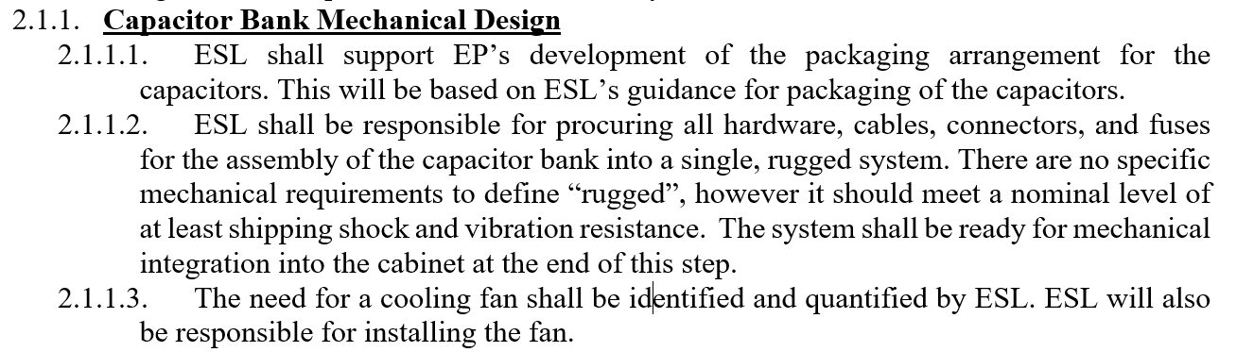
Test and Integration-Task #1, Design
Mechanical Integration
The team is using ElectroStandards Laboratories for the Integration and Testing efforts.
Specific Tasks
PCKA / EP Proprietary / ITAR Technical Data (See Cover Page for Distribution Statement)

Slide 58
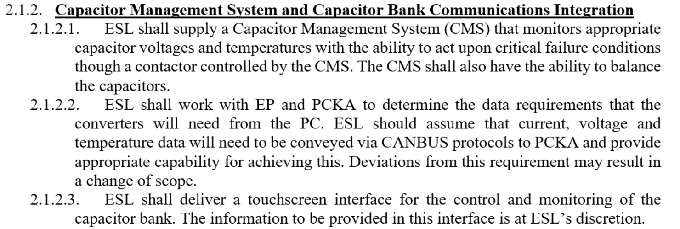
Test and Integration-Task #1, Design
PCKA / EP Proprietary / ITAR Technical Data (See Cover Page for Distribution Statement)

Slide 59
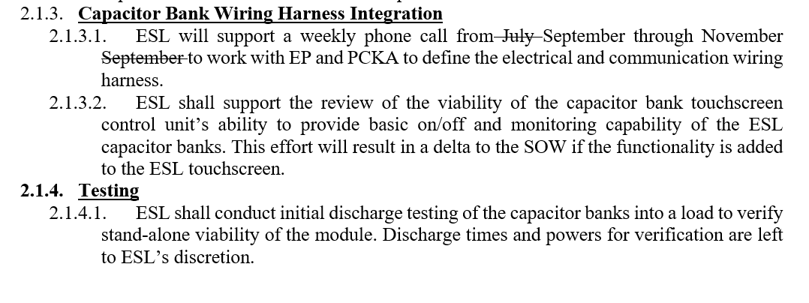
Test and Integration-Task #1, Design
PCKA / EP Proprietary / ITAR Technical Data (See Cover Page for Distribution Statement)

Slide 60
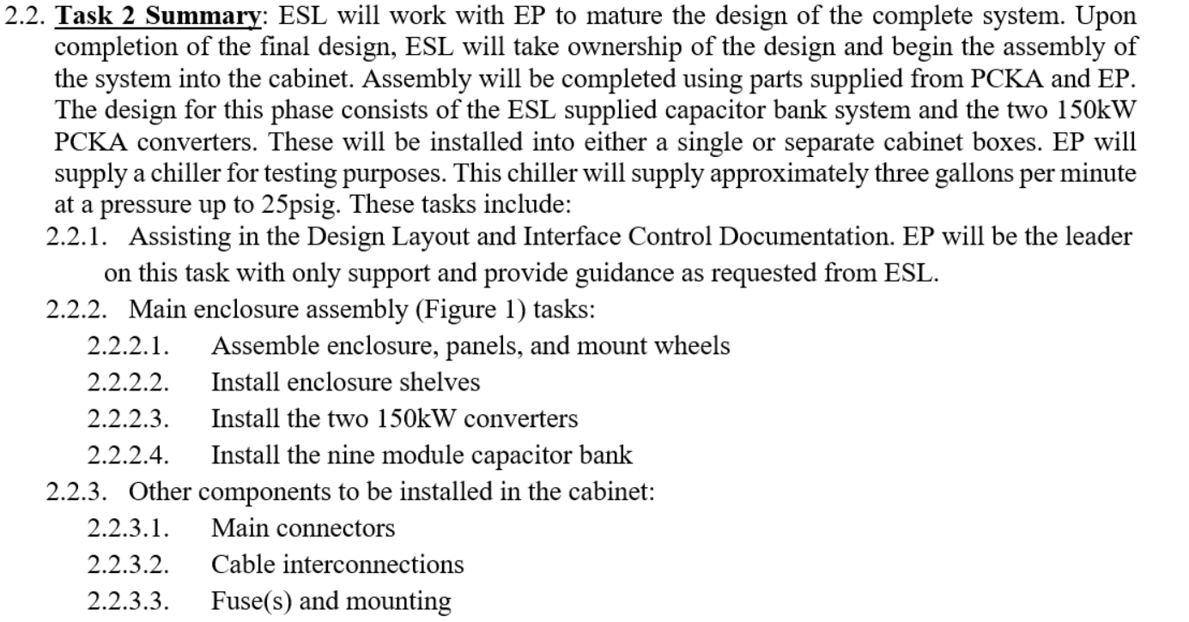
Test and Integration-Task #2, Assembly and Test
PCKA / EP Proprietary / ITAR Technical Data (See Cover Page for Distribution Statement)

Slide 61
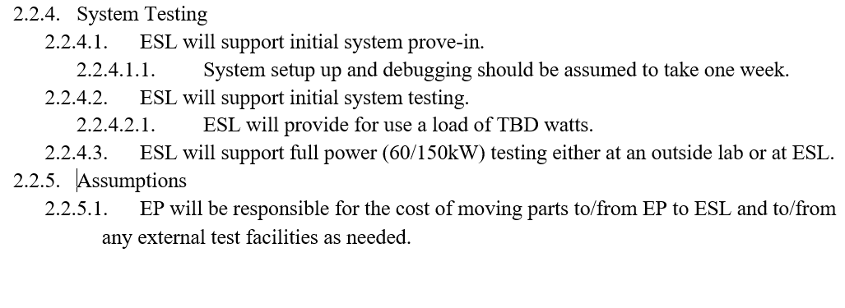
Test and Integration-Task #2, Assembly and Test
PCKA / EP Proprietary / ITAR Technical Data (See Cover Page for Distribution Statement)

Slide 62
Schedule
EP TO UPDATE

Slide 63
Closeout
Actions
# | Action | Resp | Due | Status/Method
1
2
3
4
5
6
7
8
9
10
PCKA / EP Proprietary / ITAR Technical Data (See Cover Page for Distribution Statement)

